Slide 1
EID 101D: SMART, CONNECTED DEVICES
Team Name: SPOTRA
Jai Himatsingka
SangJoon Lee (Bob)
Paul Kang
Jimmy Zhu
Christopher Jeong

Slide 2
Initial Idea

Slide 3
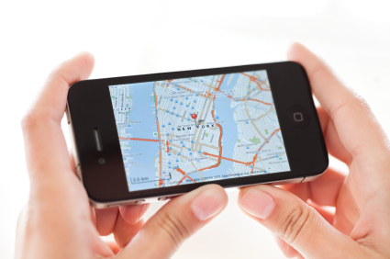
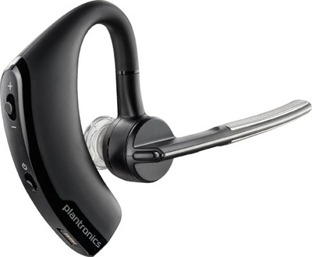


AUDIO BIKE NAVIGATION

Slide 4
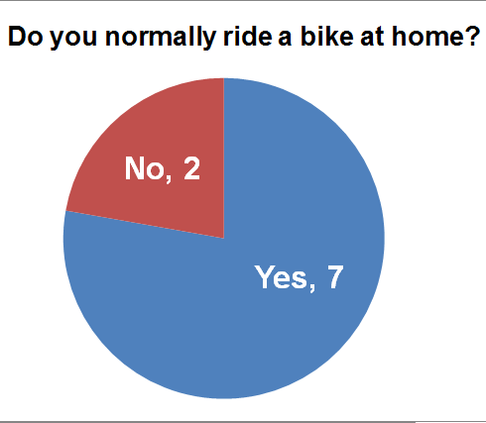
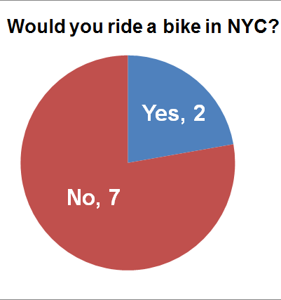
INTERVIEW DATA
Preference: Subway/Walking

Slide 5

Problem: Lack of Protected Bike Lanes

Slide 6

Q. Major Problems?

Slide 7

Interviews
Number of Interviews: 8
Results: UNINTERESTED
Reason: High Age Group
Plan : Re-Target Age Group 18-35

Slide 8
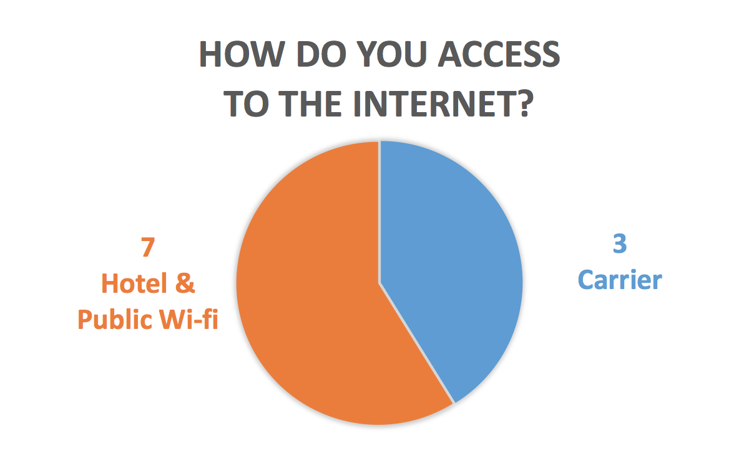


PURPOSE OF INTERNET ACCESS

Slide 9
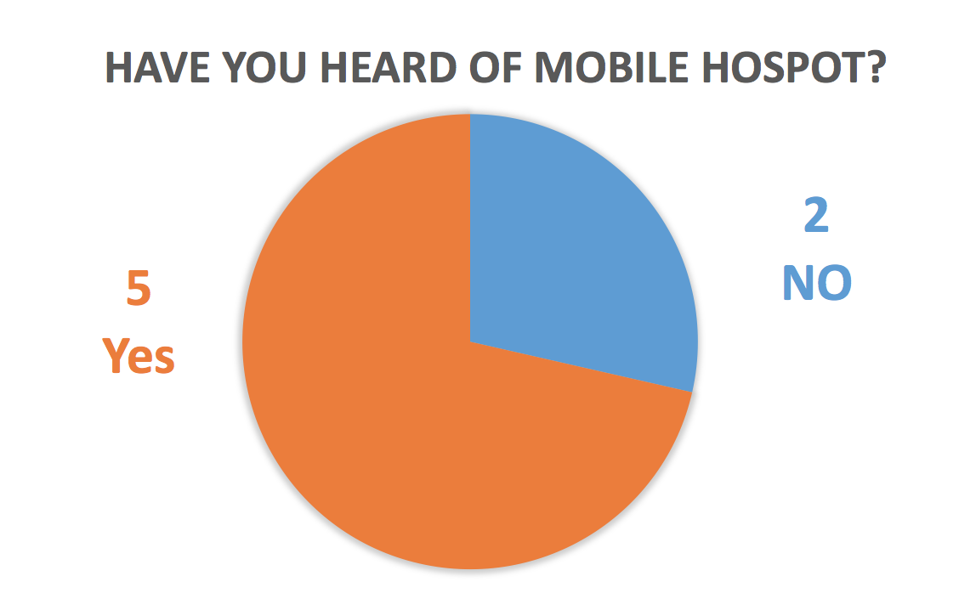

Slide 10

HOTSPOT + TRAVEL

Slide 11
Customer Segment
International Tourists in NYC
Staying for a Short duration (1-3 weeks)
Ages 18-35 (Flexible)

Slide 12
Why?

Slide 13
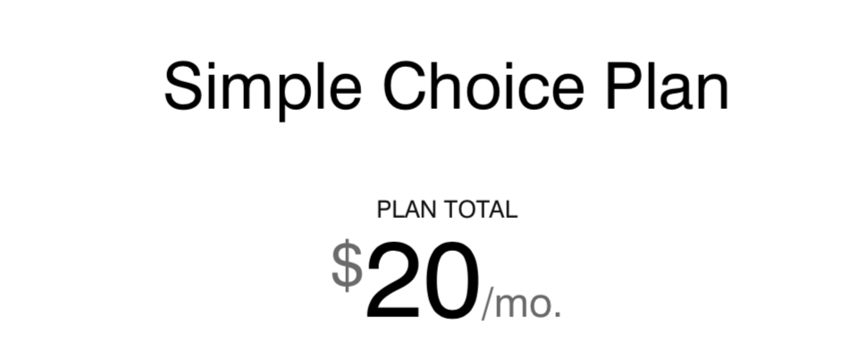


Slide 14
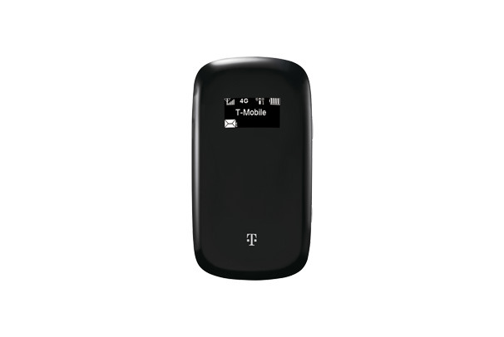
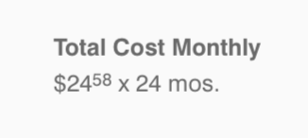
= $590 + Deposit

Slide 15


What Makes SPOTRA Different?

Slide 16
RENTAL SERVICE PLAN
7
8
5
JFK AIRPORT TERMINALS
Primary Arrival
4
Primary
Departure
1
2

Slide 17

Additional Features
Sturdy Aluminum Design
Waterproof
Quick Charging
Share connection

Slide 18
Design & Prototype

Slide 19
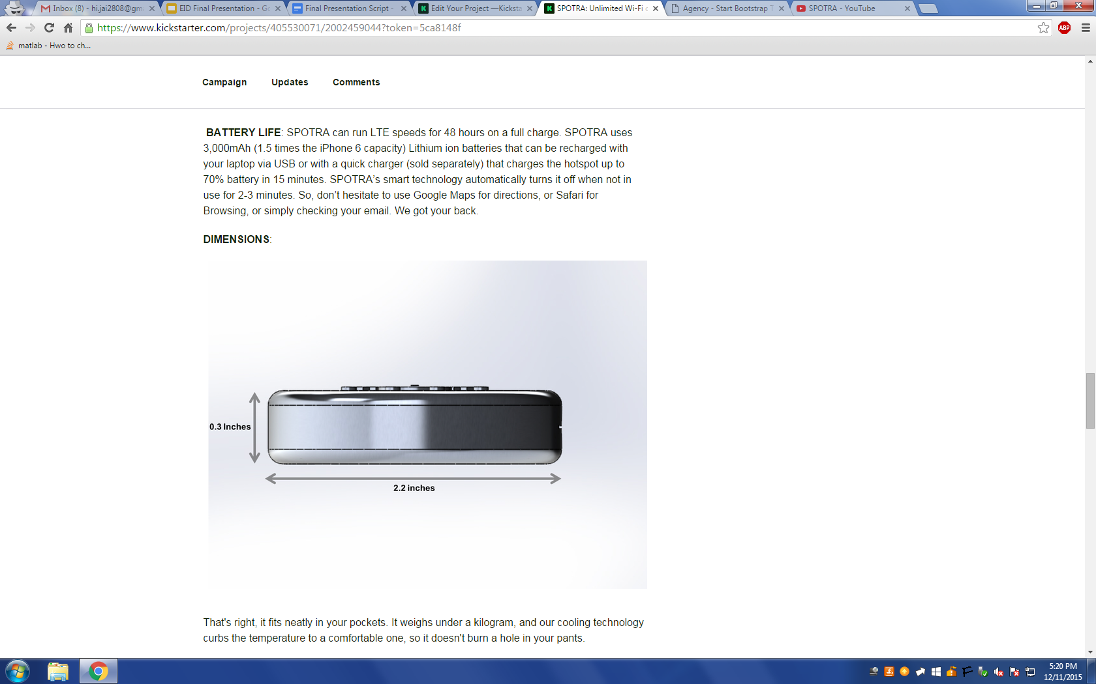
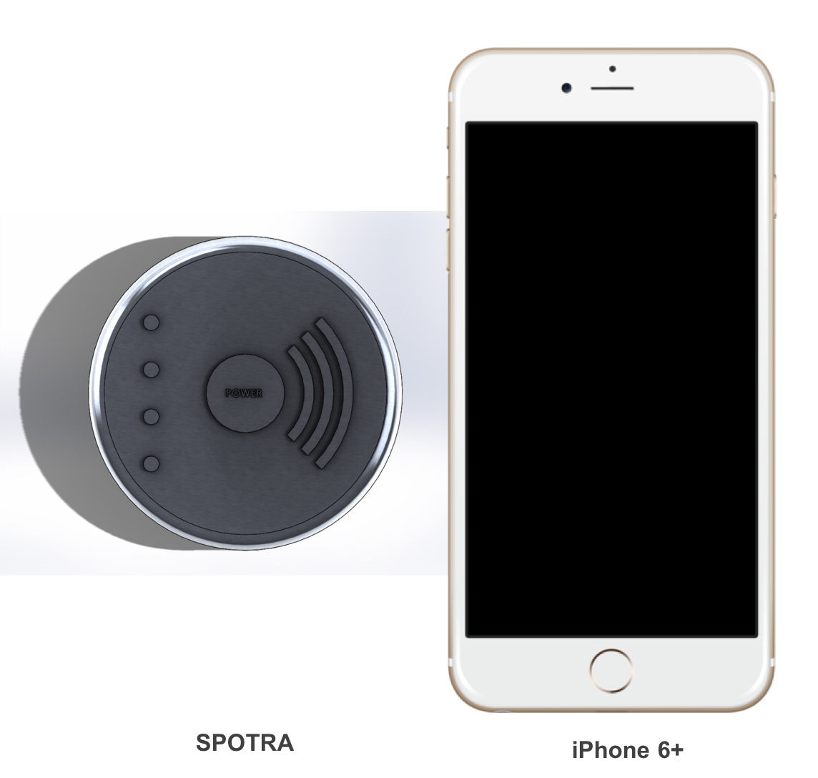
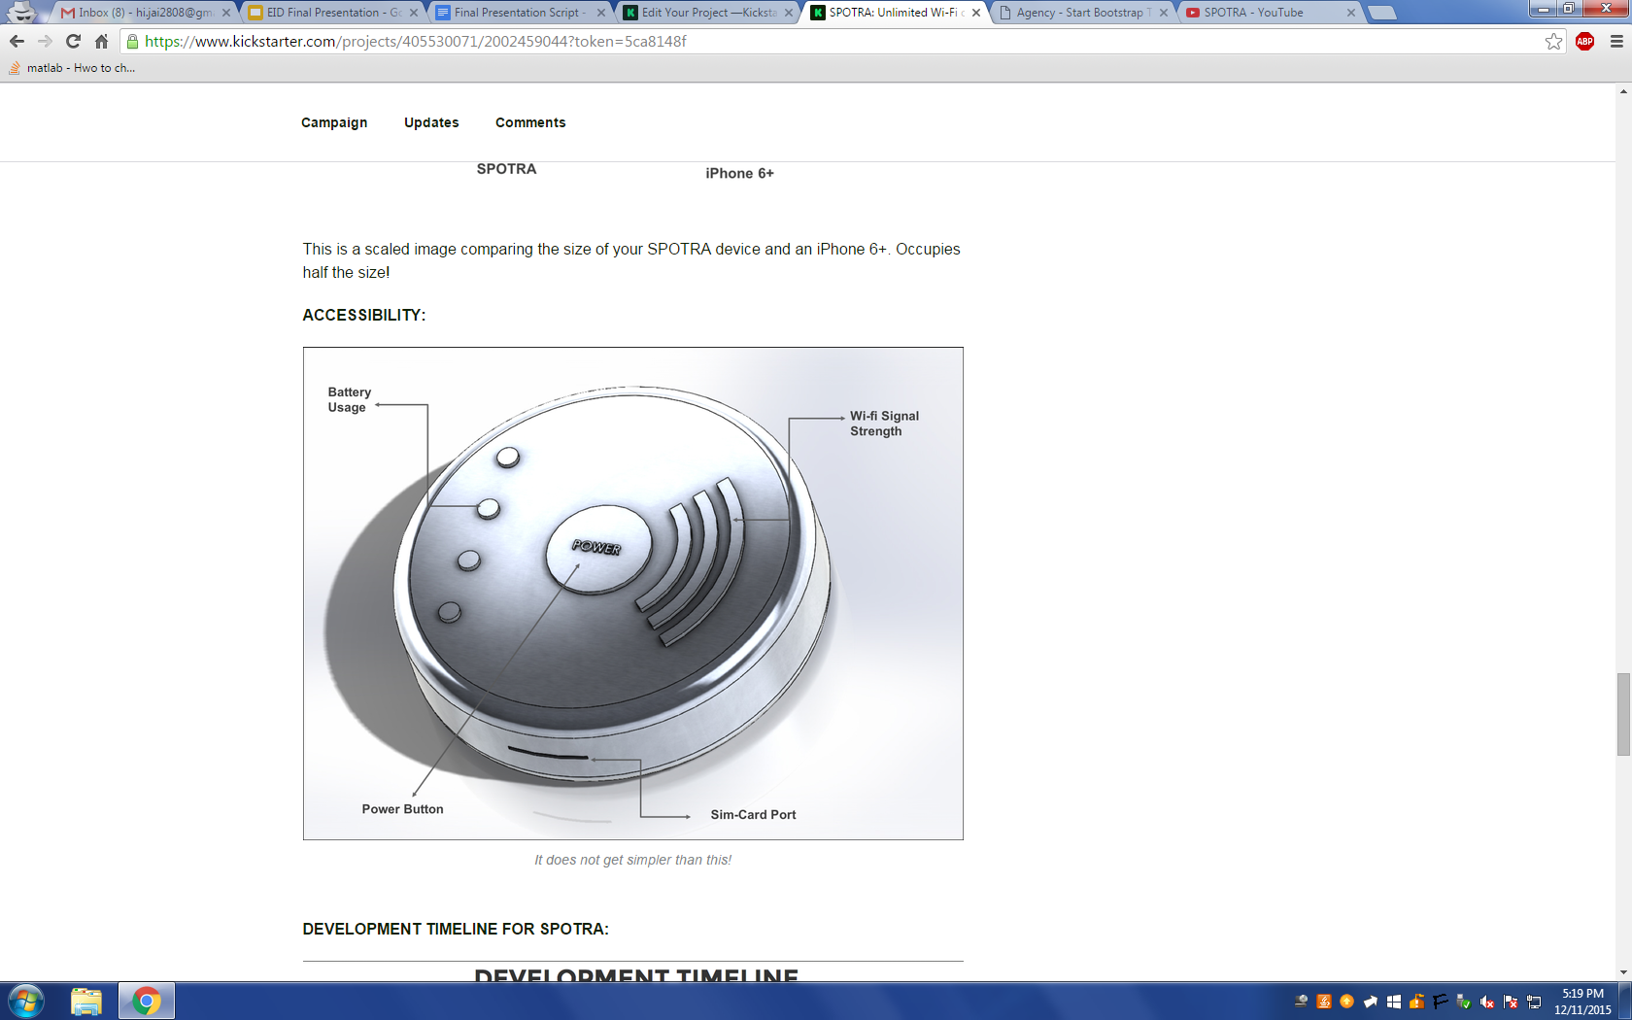

Slide 20
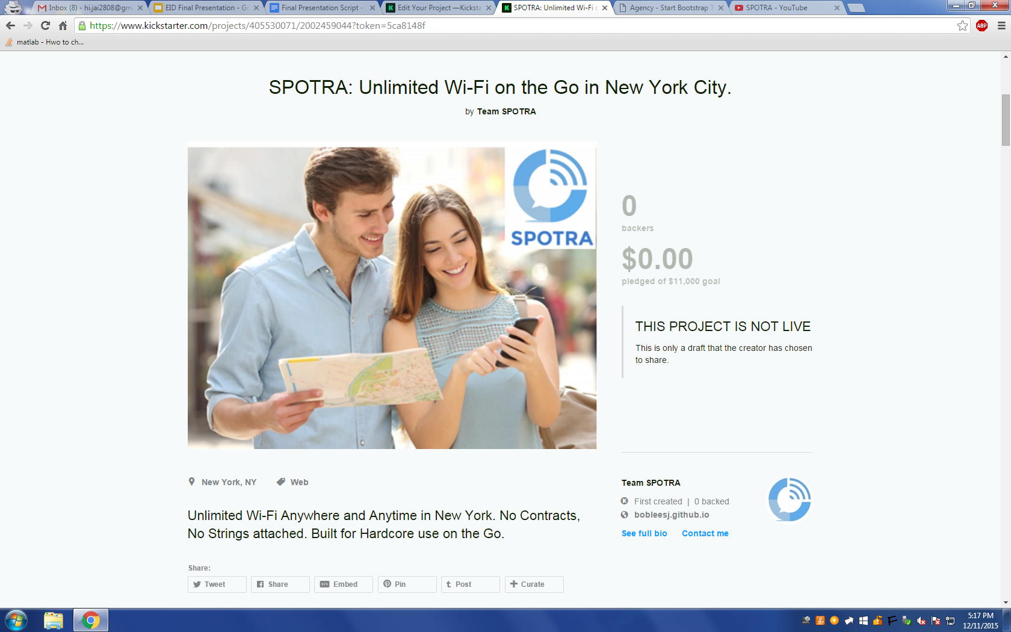
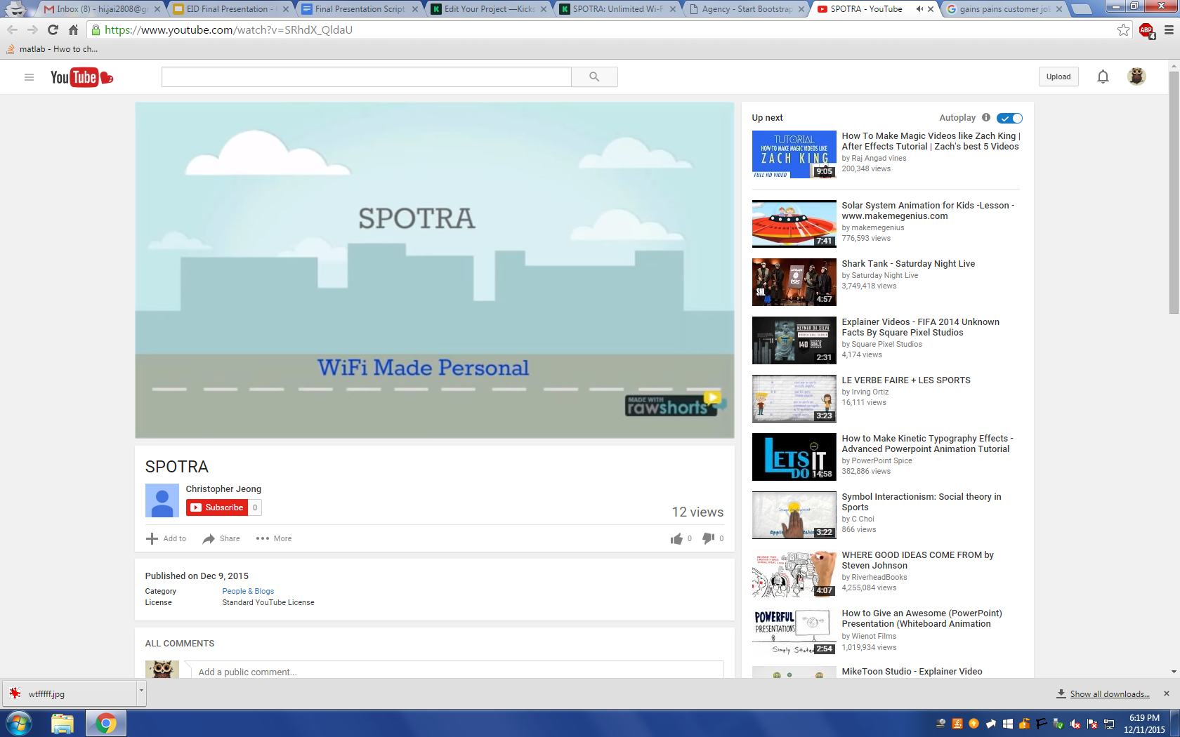
KickStarter Funding
KickStarter
YouTube
https://www.kickstarter.com/projects/405530071/2002459044?token=5ca8148f
https://www.youtube.com/watch?v=SRhdX_QldaU

Slide 21
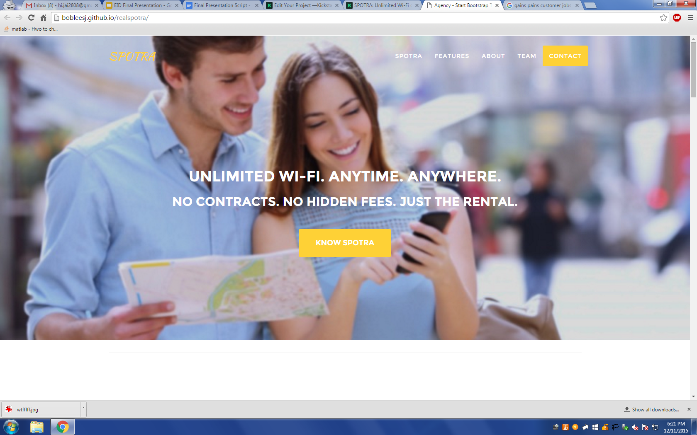
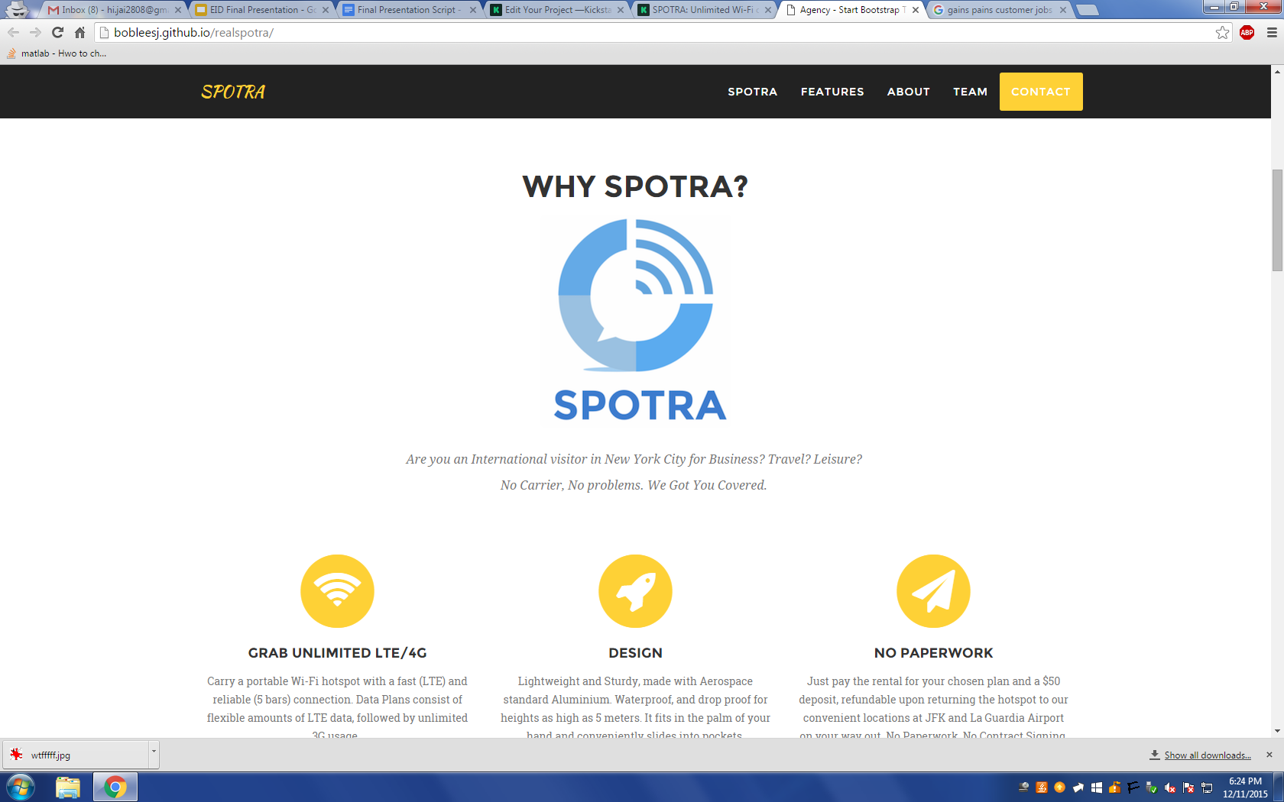
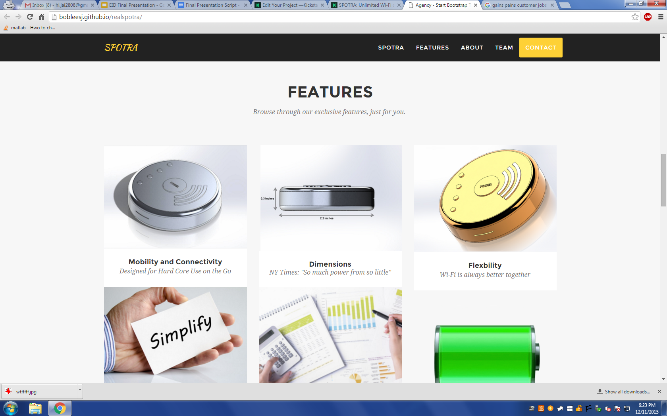
LANDING PAGE
http://bobleesj.github.io/realspotra/

Slide 22
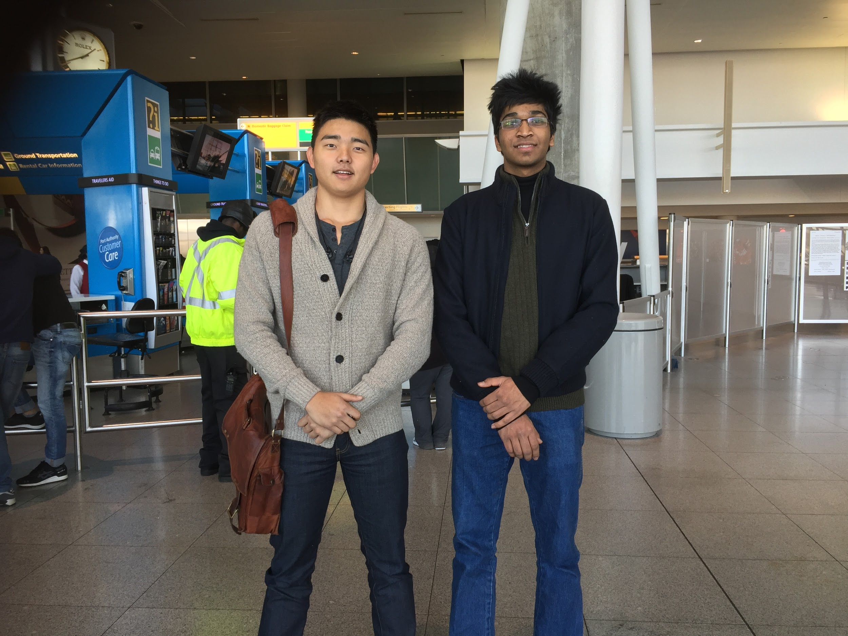
Final Interview at JFK

Slide 23
Results
Size & Mobility
Rental Service
Website - Mailing List

Slide 24
Conclusion
Business to Engineering
Interview Skills
Landing Page & Media
Prototype & 3D Print

Slide 25
Thank you

